Slide 1


Slide 2
The Psychological Phenomena in UX Design
The Principle of Least Effort
The Principle of Perpetual Habit
The Principle of Socialization
The Principle of Emotional Contagion
The Principle of Identity
The Principle of Beauty
The Magical Number Seven
The Psychology of Mistakes
Focus , Attention and Concentration

Slide 3
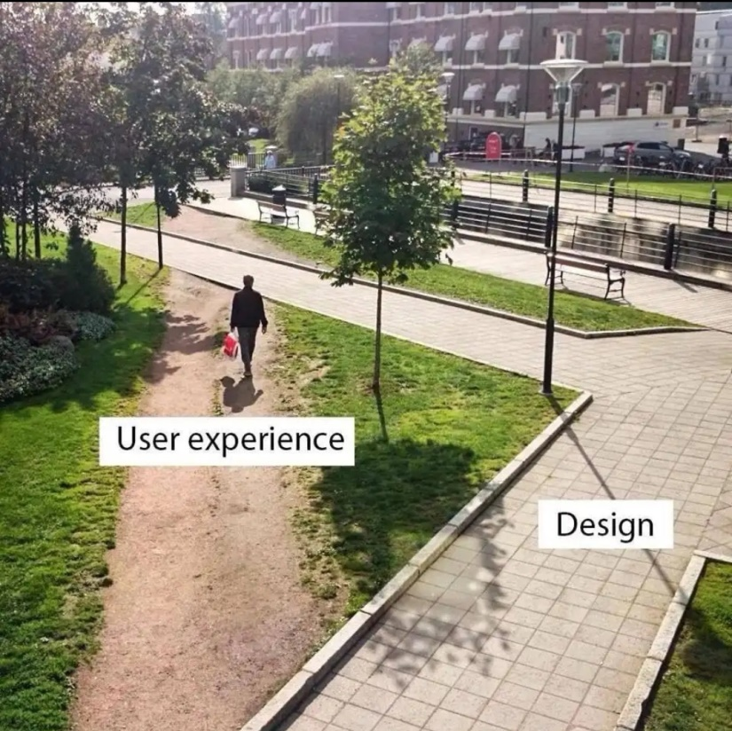
The Principle of Least Effort
The Principle of Least Effort is pretty simple and self-explanatory : people are looking for ways to complete tasks with the least possible effort.
When you have to explain something to your users, for instance, when onboarding them instead of telling about it in the text.
When you choose to explain something in the text, make sure that this text is as concise as possible, that all the information is meaningful and important.
Similar information, use grouping.
Make sure that the users understand well what they can or cannot click.
The opportunity to use a decorative font may seem very attractive, but make sure that this font is legible.

Slide 4
The Principle of Perpetual Habit
The Principle of Perpetual Habit states that people greatly on their memory
And habit when doing this or that task.
Do not grow too desperate in your effort to make the website stand out. Keep the things traditional where they should be. For instance, the footer should be at the bottom of the page and the side panel should be to the left.
Keep the website layout and navigation simple so that user could learn to go around your website in one or two sessions. All the essential pages have to be one click away from the home page.

Slide 5

The Principle of Socialization
People want to be social and they greatly rely on technology in order to achieve it.
You absolutely must implement buttons for social media. Users can access your accounts on different social media platforms.
Implement product ratings, app reviews or client testimonials for the users to see that the product or service you provide is loved by other people.

Slide 6
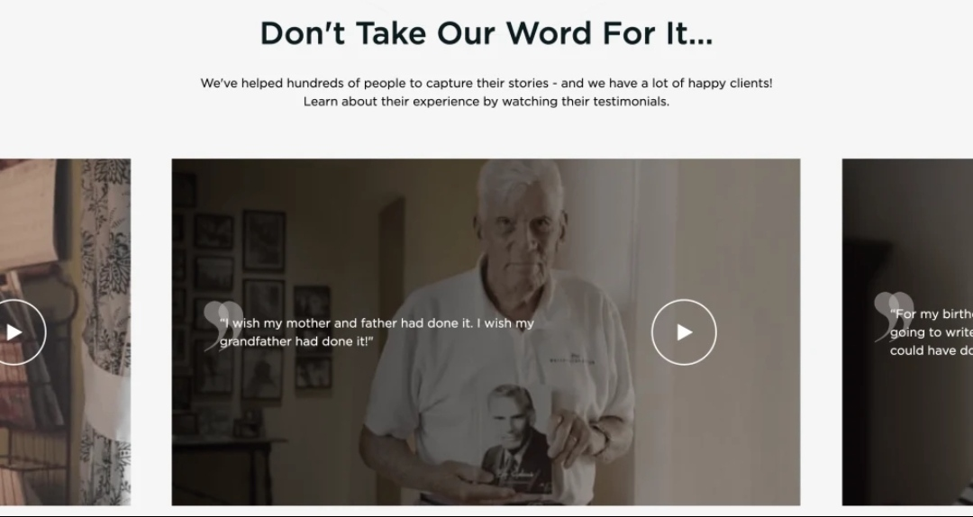
The Principle of Emotional Contagion
Have you ever noticed that emotions are contagious?
If a person you like is laughing out loud, you will be smiling.

Slide 7
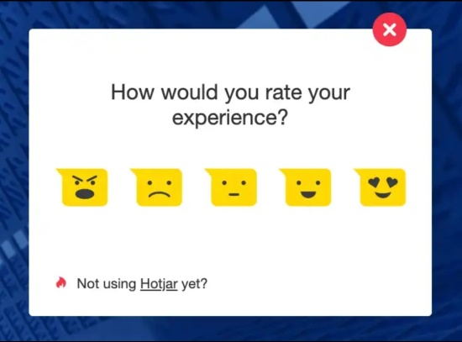
The Principle of Identity
All people need a sense of identity, a feeling of belonging, an understanding of who you are.
Develop your company brand. Use unique color, logos. Message in order to underscore the uniqueness of your brand.
Show that you care about your users. At each stage of user experience, provide your users with feedback.
Do not forget to ask for feedback from your users. However , make sure that this form is not annoying-it should be easy to skip or close, and it should not turn out too often.

Slide 8

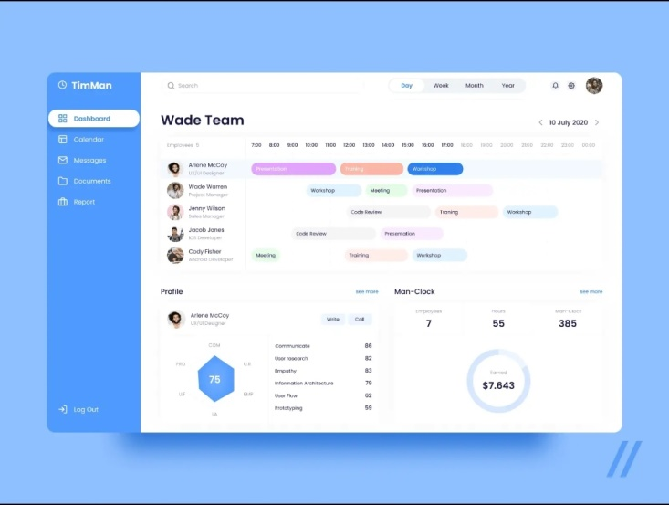
The Principle of Beauty
Numerous psychological studies prove beautiful people and beautiful things are always more loved. People choose books by their cover.
In the psychology of web design, beauty is all about User Interface.
Create a design system. Do not mix fonts, colors, button styles, navigation elements, icons.

Slide 9
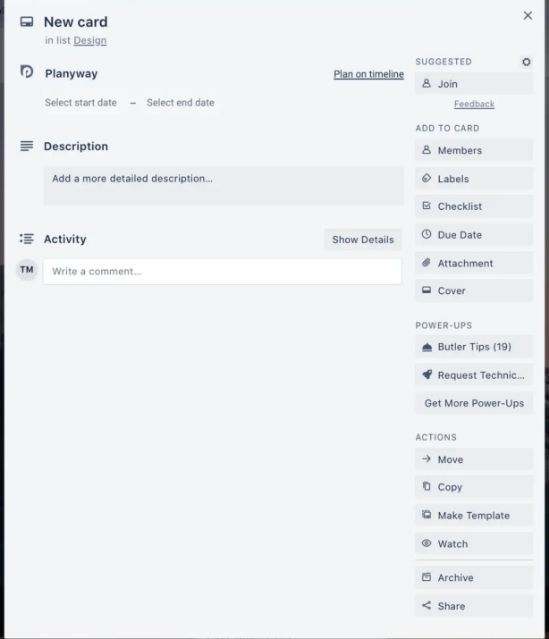
The Magical Number Seven
A person can hold from five to nine things in their short-term memory.
Do not make people remember more than they can remember.
If there is a lot of information to be given to the user, disclose it progressively.

Slide 10
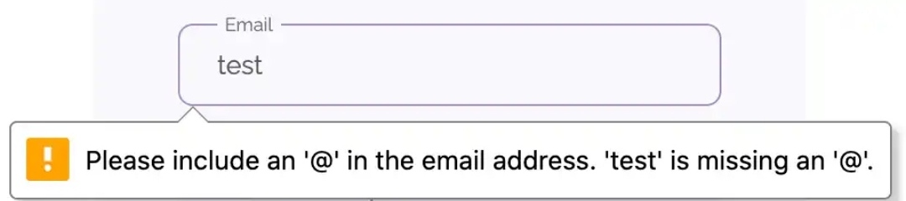
The Psychology of Mistakes
All people make mistakes. Mistake spark a wide range of emotions in people’s minds.
Try to predict where users may make mistakes, which function or flow may seem obscure or confusing and eliminate such uncertainties.
Do not neglect the “undo” button.

Slide 11
Focus, Attention and Concentration
Normally, the attention span of an adult is from ten to twenty minutes. After this short time, people tend to lose focus and concentration and get distracted by their own thoughts or the things around them.
Do not use random pop-ups, banners or sounds in order not to distract your users.
Your product has to stand out – people are attracted to and interested in something new.

Slide 12


